Slide 1

Tutorial 1:
Exploring Soil Biogeochemistry & Respiration Data by Using MONet Shiny App
Qian Zhao, Layton Washburn, Kaizad Patel

Slide 2
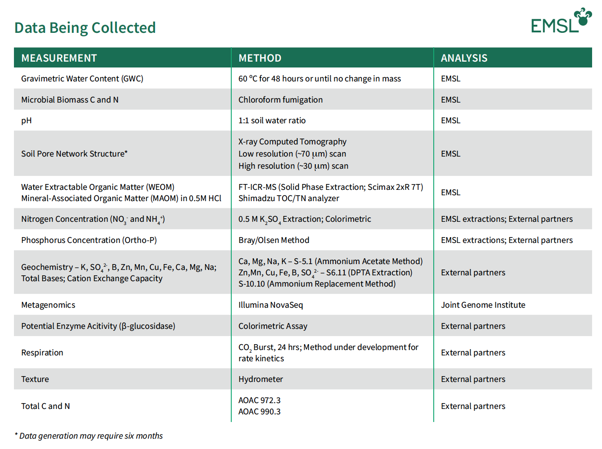
Data Being Collected
More than 30 different data types
https://www.emsl.pnnl.gov/monet

Slide 3
Data Being Collected
Biogeochemistry Analyses
https://www.emsl.pnnl.gov/monet

Slide 4
Biogeochemical Data and Protocols
Geochemistry
Ca, Mg, Na, K – Ammonium Acetate method
Zn, Mn, Cu, Fe, B, SO₄-S – DTPA (diethylenetriaminepentaacetic acid)
Cation Exchange Capacity (CEC) – Ammonium Replacement Method.
Texture – Hydrometer
Extractable nutrients
NH₄-N, NO₃-N – extracted with 0.5M K₂SO₄; measured by colorimetric approach.
PO₄-P:
Bray method: Bray solution (0.025M HCl & 0.03M NH₄F)
Olsen method: 0.5M NaHCO₃ extraction solution
Analyzed by ICP-OES.
Analyzed by the Murphy-Riley Method (colorimeter at 880nm).
References:
Bray, R.H. and L.T. Kurtz 1945. Determination of total, organic and available phosphorus in soil. Soil Sci. 59:39-45.
Olsen, S. R. and Sommers, L. E. 1982. Phosphorus. pp. 403-430. In: A. L. Page, et al. (eds.) Methods of soil analysis: Part 2. Chemical and microbiological properties. Agron. Mongr. 9. 2nd ed. ASA and SSSA, Madison, WI.
Notes:
Cation Exchange Capacity (CEC) – Ammonium Replacement Method. Ammonium acetate to replace all exchangeable cations. Then, use 0.1M HCl to replace the exchangeable ammonium. Ammonium-N was measured ALPKEM rapid flow analyzer to determine the CEC.

Slide 5
Biogeochemical Data and Protocols
Bulk chemistry
Total C, total N – TOC analyzer via combustion
pH – 1:1 soil to water ratio
Respiration:
Rewet air-dried soil and measure CO₂ in 24 and 96 hours via infrared gas analysis.
Respirometer – Biological oxygen demand.
Water extractable C & N – extract at 1:5 soil to water ratio; measured by TOC analyzer.
Mineral associated organic matter – extract with 0.5M HCl; measured by TOC analyzer.
Microbiology
Microbial biomass C & N:
0.5M K₂SO₄ extraction – salt extractable C & N
Chloroform fumigation – microbial biomass C & N
Measured by TOC analyzer for C & N concentrations.
Enzyme activity – 𝛽-glucosidase measures with a spectrophotometer at 405 nm.
References:
Marx, M. C., Wood, M., & Jarvis, S. C. (2001). A microplate fluorimetric assay for the study of enzyme diversity in soils. Soil biology and biochemistry, 33(12-13), 1633-1640.
Notes:
β-Glucosidase completes the final step of hydrolysis by converting the cellobiose to glucose

Slide 6

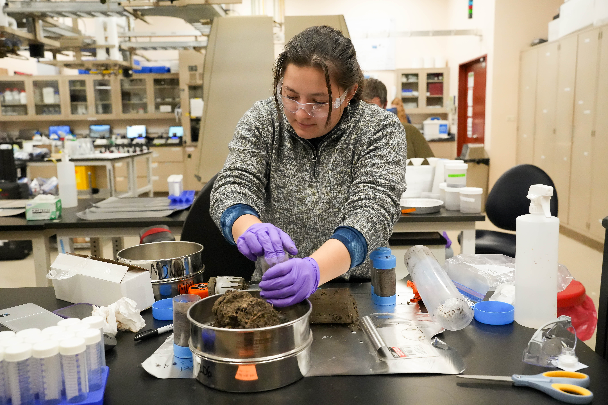
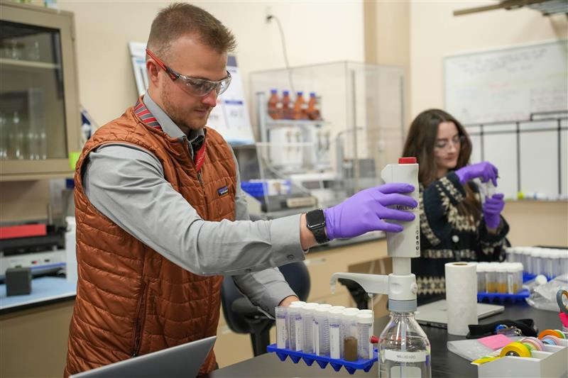
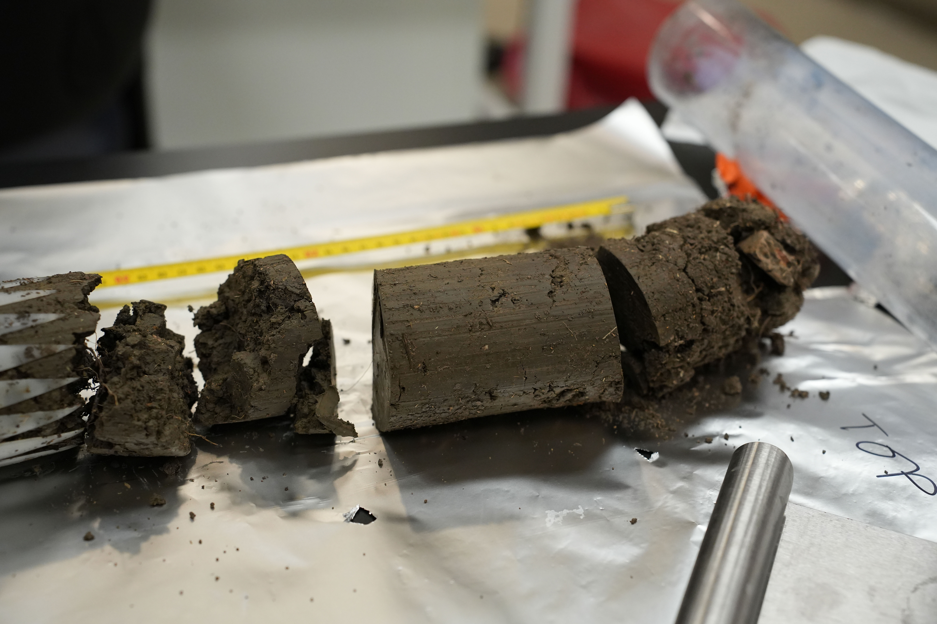

Slide 7
Biogeochemistry Analyses
MONet | NEON
Gravimetric Water Content (GWC) | Soil CO₂ concentration
Microbial Biomass C and N | Soil heat flux plate
pH | Soil inorganic nitrogen pools and transformations
Soil Pore Network Structure | Soil microbe biomass
Water Extractable Organic Matter (WEOM) | Soil microbe community composition
Mineral-Associated Organic Matter (MAOM) | Soil microbe group abundances
Nitrogen Concentration (NO3- and NH4-) | Soil microbe marker gene sequences
Phosphorus Concentration (Ortho-P) | Soil microbe metagenome sequences
Geochemistry - K, SO42-, B, Zn, Mn, Cu, Fe, Ca, Mg, Na, Total Bases, CEC | Soil physical and chemical properties, distributed initial characterization
Metagenomics | Soil stable isotopes, periodic
Potential Enzyme Activitiy (𝛽-glucosidase) | Soil temperature
Respiration | Soil water content and water salinity
Texture | Vegetation structure
Total C and N | Wet deposition chemical analysis
 | Root chemical properties
 | Root stable isotopes
https://www.emsl.pnnl.gov/monet
https://data.neonscience.org/

Slide 8

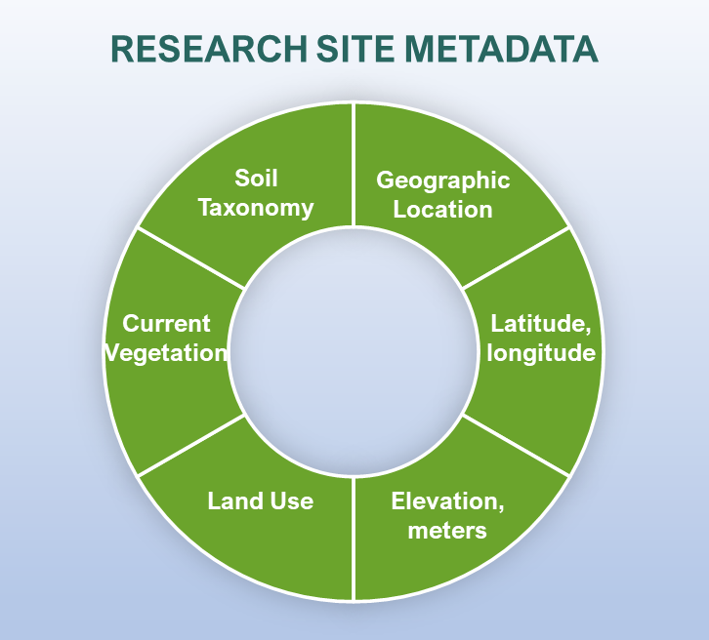
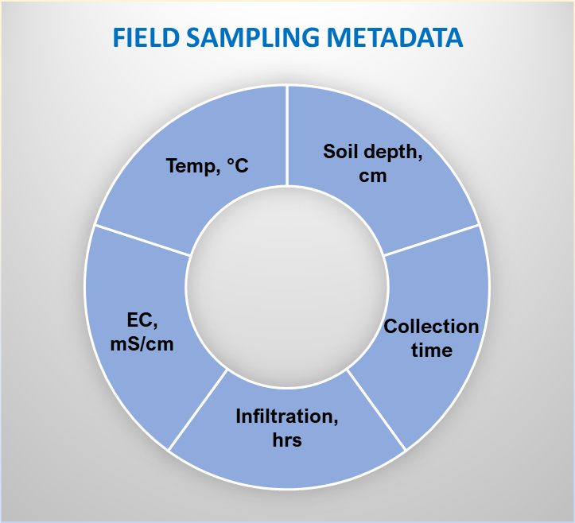
Collect Metadata
MONet Types of Metadata
Additional public-facing auxiliary data (atmospheric, groundwater, eddy-covariance, plant phenotype, etc.)
Notes:
What does submission process look like for a MONet participant.
A simplified the process, minimize barriers of participation. MONet participants complete a short form 250 to 500 words, brief description of their research.
Submit a proposal through EMSL portal, describing the metadata.
PI, collect and send soil cores

Slide 9



Qian Zhao
Processing respiration data
Layton Washburn
Introduction to the 1000 Soils Shiny App
Kaizad Patel
Processing, visualizing, and interpreting biogeochemistry data

Slide 10
Tutorial 1:
Exploring Respiration Data
Qian Zhao
Earth Scientist

Slide 11
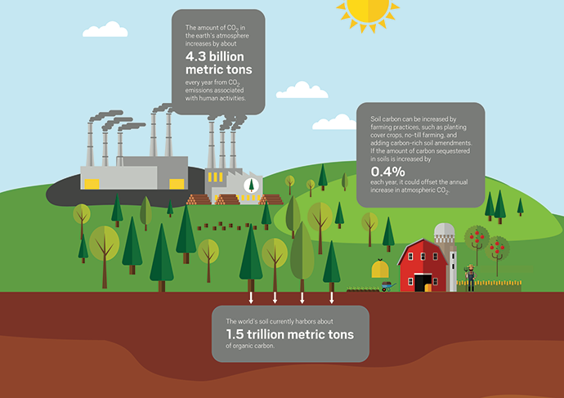
Global carbon cycle
9.4
Billion metric tons of C/yr
107.2 Billion metric tons C/yr
112.9 Billion metric tons C/yr
Soil – C Source?
Carbon in Soil
~3000 Billion metric tons
Soil – C Sink?
(Adapted from Britt E. Erickson, http://cen.acs.org)

Slide 12
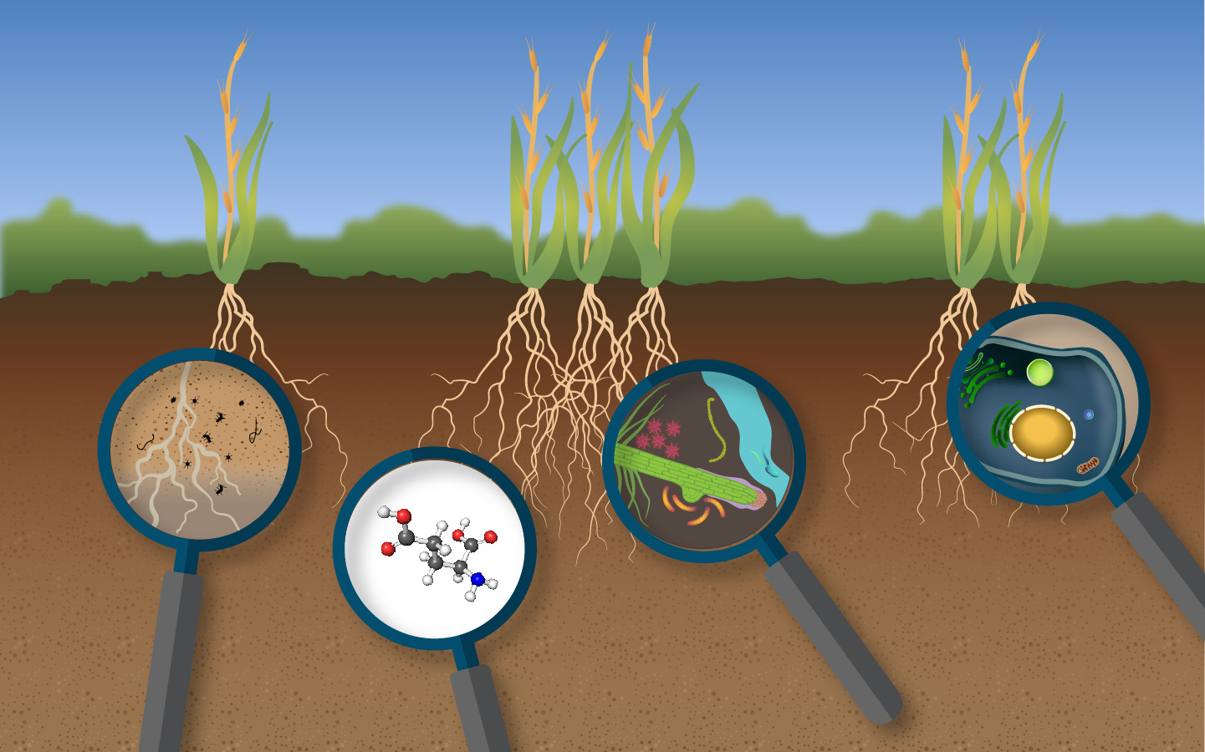
Soil Respiration is regulated by microbes, organic chemistry, and plant root inputs.
CO₂
CO₂
CO₂
CO₂

Slide 13
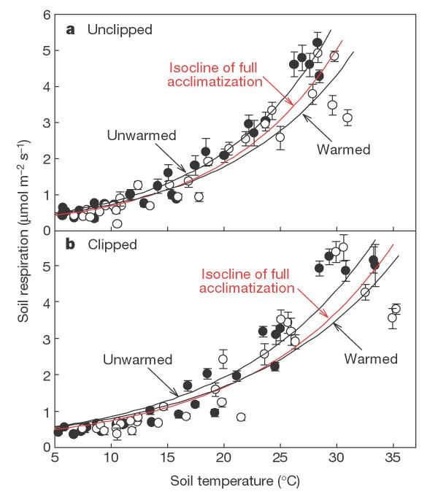
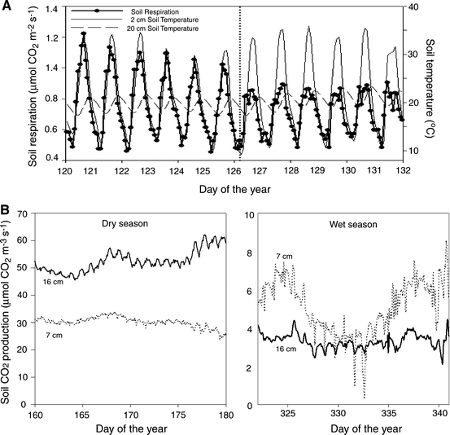
Soil respiration can be changed with temperature, season, and other variables.
Luo et al. Acclimatization of soil respiration to warming in a tall grass prairie. Nature 413, 622–625 (2001). https://doi.org/10.1038/35098065
Vargas et al. Frontiers and challenges in soil respiration research: from measurements to model-data integration. Biogeochemistry 102, 1–13 (2011). https://doi.org/10.1007/s10533-010-9462-1

Slide 14
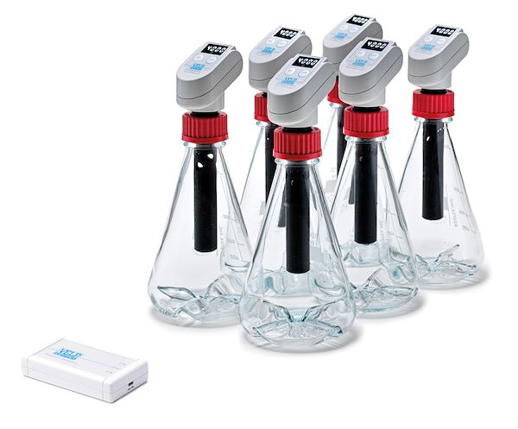
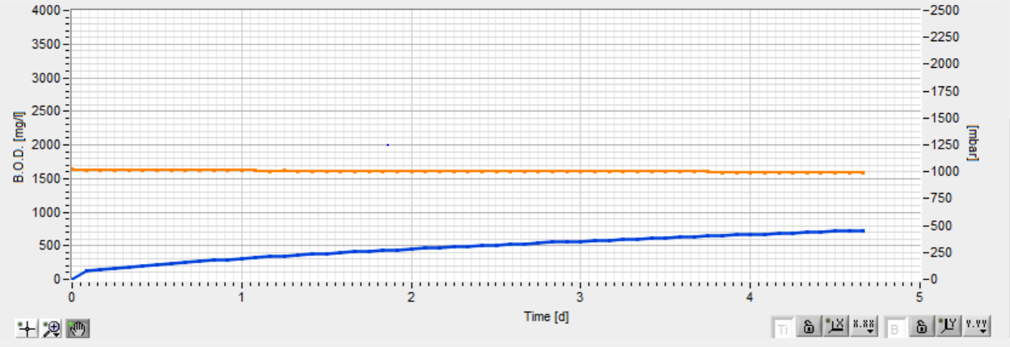
Our Respiration Protocol
Protocol:
50 g field moisture soil added to flask.
Respirometer and incubation flask are placed in 21℃ chamber and acclimated for two hours.
6 KOH pellets added to alkali collector
Decreased pressure → O₂ consumption
The kinetics was measured every two hours for 5 days.
Respirometer provides BOD (mg/L) as raw data.
CO₂ + 2KOH → K₂CO₃ + H₂O
Orange= Pressure
Blue= BOD (mg/L)

Slide 15
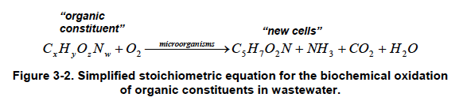
From Raw to Processed Data
Converting BOD_mg/L (raw data) to CO₂_mg/g (Processed data)
Converting CO₂ unit from mg/L to mg/g by multiplying volume of headspace and dividing soil dry weight.
BOD/32 (MW of O2) x 44 (MW of CO₂)
 | A | B | C | D
 | Sample_ID | XYZ
1 | Headspace_vol_L | 0.97
2 | Dry_Soil_Mass_g | 50
3
4
5 | Time_hr | BOD_mg/L | CO₂_mg/L | CO₂_mg/g
6 | 0 | 0.0 | 0 | 0.000
7 | 2 | 22.0 | 30.25 | 0.618
8 | 4 | 22.0 | 30.25 | 0.618
9 | 6 | 24.0 | 33 | 0.674
10 | 8 | 24.0 | 33 | 0.674
11 | 10 | 32.0 | 44 | 0.899
12 | 12 | 32.0 | 44 | 0.899
Goldsmith, J., Coburn, J., Neulicht, R., & Bronstein, K. E. (2010). Greenhouse gas emissions estimation methodologies for biogenic emissions from selected source categories: Solid waste disposal, wastewater treatment, ethanol fermentation. U.S EPA.

Slide 16
Fitting Respiration Data
Fit the kinetics data with 1st order respiration model:
CO₂ = B + A*(1-exp(-k*t))
CO₂ is the CO₂ concentration, B is the initial CO₂ concentration at time 0, A is the maximum CO₂ generation in the sample, k is the rate constant (hr⁻¹), t is the time (hr).
 | A | B | C | D | E | F
 | Sample_ID | XYZ |  | B | 0.108
1 | Headspace_vol_L | 0.97 |  | A | 1.714
2 | Dry_Soil_Mass_g | 50 |  | k | 0.068
3 |  |  |  | Sum of chi sq | 0.527
4
5 | Time_hr | BOD_mg/L | CO₂_mg/L | CO₂_mg/g | Predicted CO₂ | Chi sq
6 | 0 | 0.0 | 0 | 0.000 | 0.108 | 0.012
7 | 2 | 22.0 | 30.25 | 0.618 | 0.326 | 0.085
8 | 4 | 22.0 | 30.25 | 0.618 | 0.516 | 0.010
9 | 6 | 24.0 | 33 | 0.674 | 0.682 | 0.000
10 | 8 | 24.0 | 33 | 0.674 | 0.827 | 0.023
11 | 10 | 32.0 | 44 | 0.899 | 0.954 | 0.003
12 | 12 | 32.0 | 44 | 0.899 | 1.064 | 0.027

Slide 17
Fitting Respiration Data
 | A | B | C | D | E | F
 | Sample_ID | XYZ |  | B | 0.108
1 | Headspace_vol_L | 0.97 |  | A | 1.714
2 | Dry_Soil_Mass_g | 50 |  | k | 0.068
3 |  |  |  | Sum of chi sq | 0.527
4
5 | Time_hr | BOD_mg/L | CO₂_mg/L | CO₂_mg/g | Predicted CO₂ | Chi sq
6 | 0 | 0.0 | 0 | 0.000 | 0.108 | 0.012
7 | 2 | 22.0 | 30.25 | 0.618 | 0.326 | 0.085
8 | 4 | 22.0 | 30.25 | 0.618 | 0.516 | 0.010
9 | 6 | 24.0 | 33 | 0.674 | 0.682 | 0.000
10 | 8 | 24.0 | 33 | 0.674 | 0.827 | 0.023
11 | 10 | 32.0 | 44 | 0.899 | 0.954 | 0.003
12 | 12 | 32.0 | 44 | 0.899 | 1.064 | 0.027
Cumulative CO₂ (mg/g)
Time (hr)

Slide 18
Data Being Collected
Biogeochemistry Analyses
https://www.emsl.pnnl.gov/monet

Slide 19
Tutorial 1:
Deep Dive in MONet Shiny App Visualization Tool
Layton Washburn
Tech Student

Slide 20
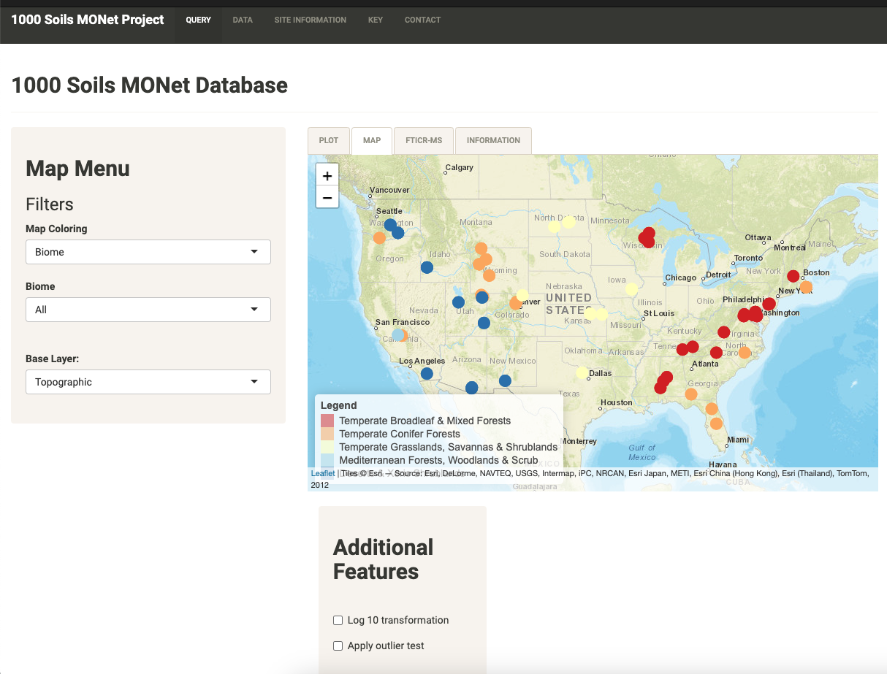
Overview of MONet Shiny App
A visualization tool to explore MONet data
A website-based app that is publicly available to everyone
A pilot app for future MONet data portal
1000 soil pilot study database
https://shinyproxy.emsl.pnnl.gov/app/1000soils

Slide 21
Tutorial 1:
Exploring Biogeochemistry Data
Kaizad Patel
Soil Scientist

Slide 22
(Bio) geochemical analytes
Bulk chemistry
TC, TN, C:N
pH
Extractable CN
WEOC, WETN
Microbial biomass
MBC, MBN
Extractable bases
Ca, Mg, Na, K
Bases, CEC
Extractable nutrients
NH₄-N, NO₃-N
SO₄-S
Extractable metals
Cu, Fe, Zn
Texture
Sand, Silt, Clay

Slide 23
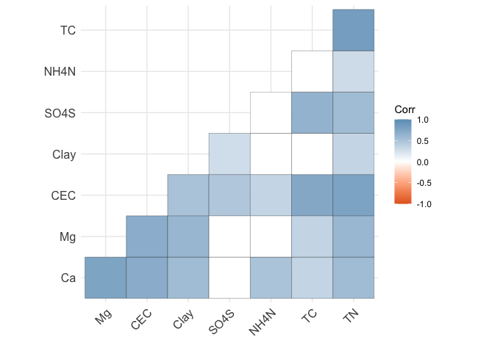
Correlations

Slide 24
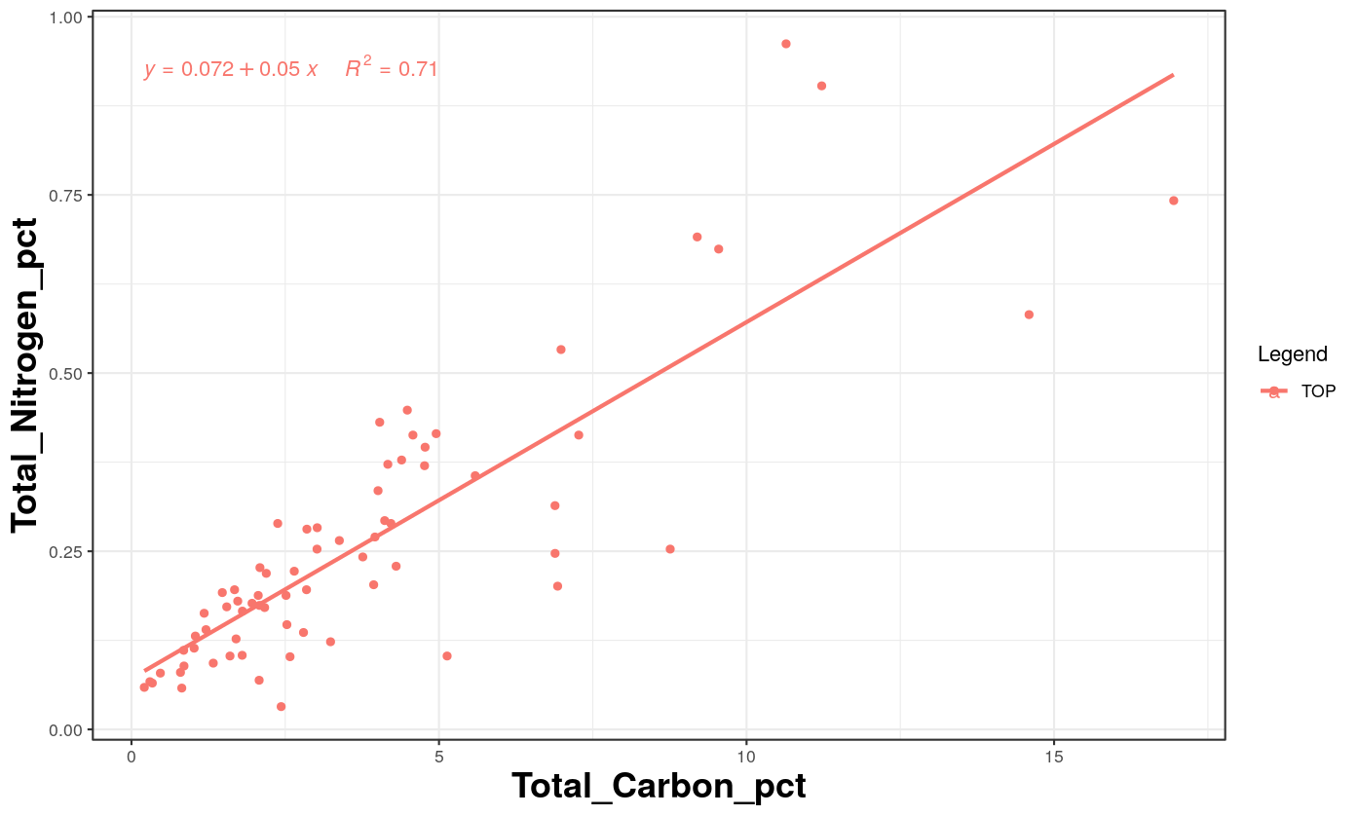
Correlations
Correlations using the Shiny App

Slide 25
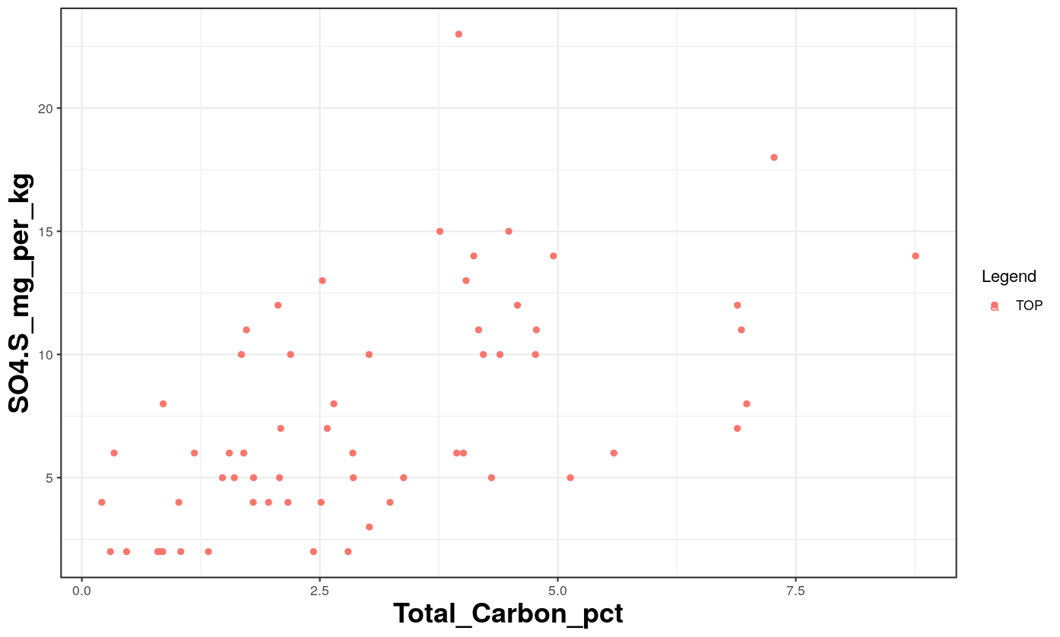
Correlations

Slide 26
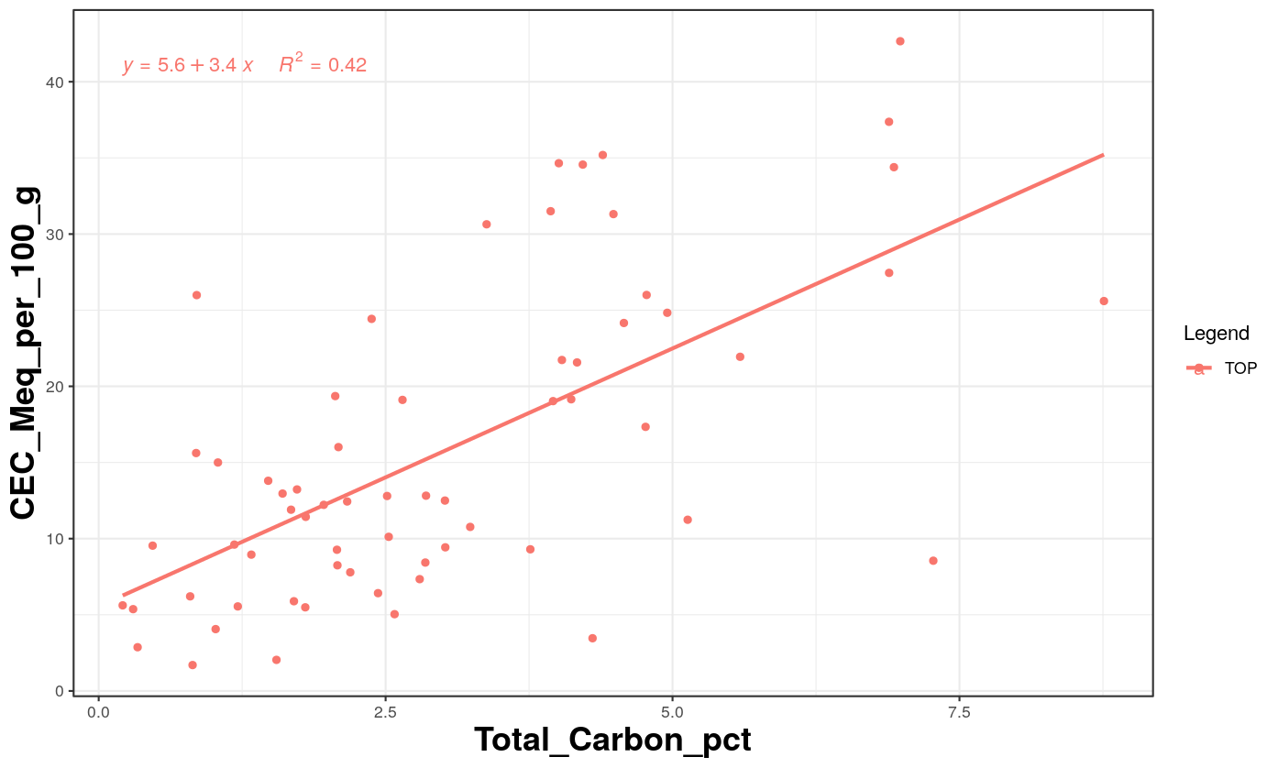
Correlations

Slide 27
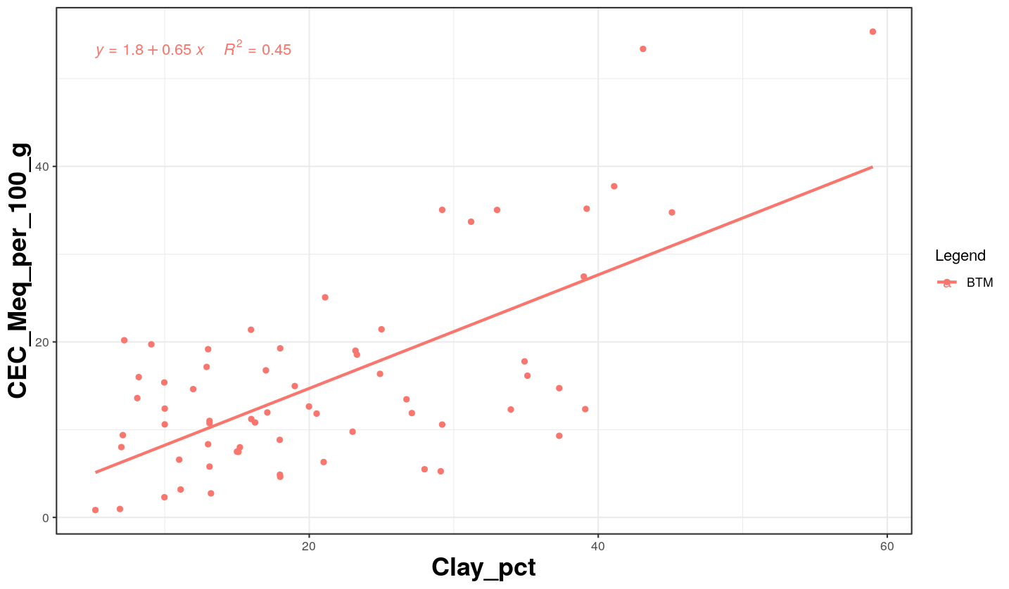
Correlations

Slide 28
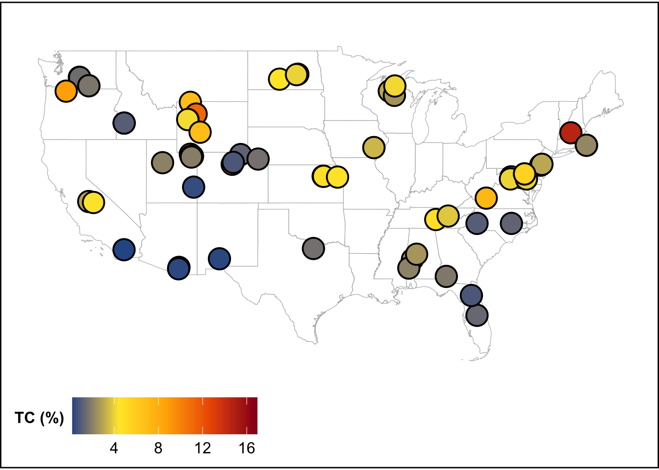


Total C
Total carbon by combustion

Slide 29
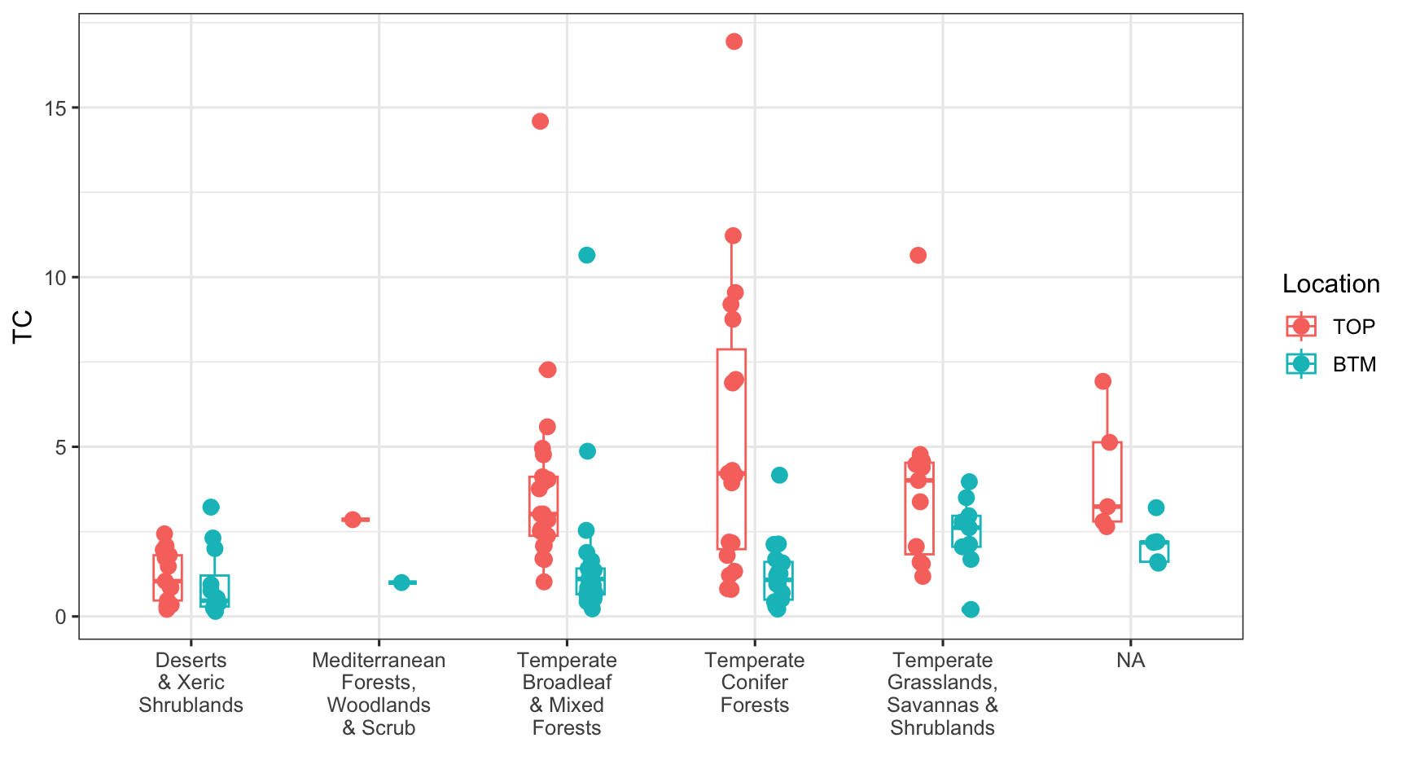
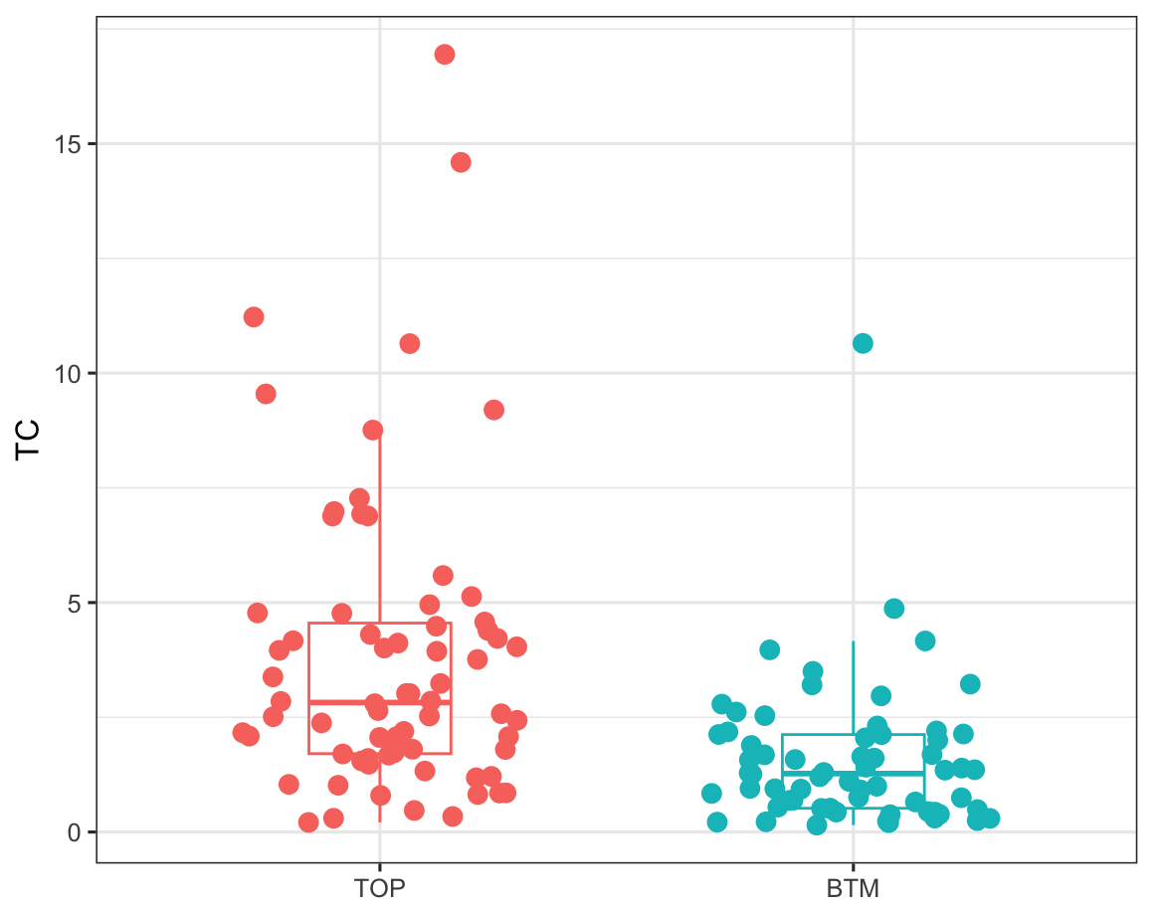
Total C
TC significantly influenced by depth and biome

Slide 30
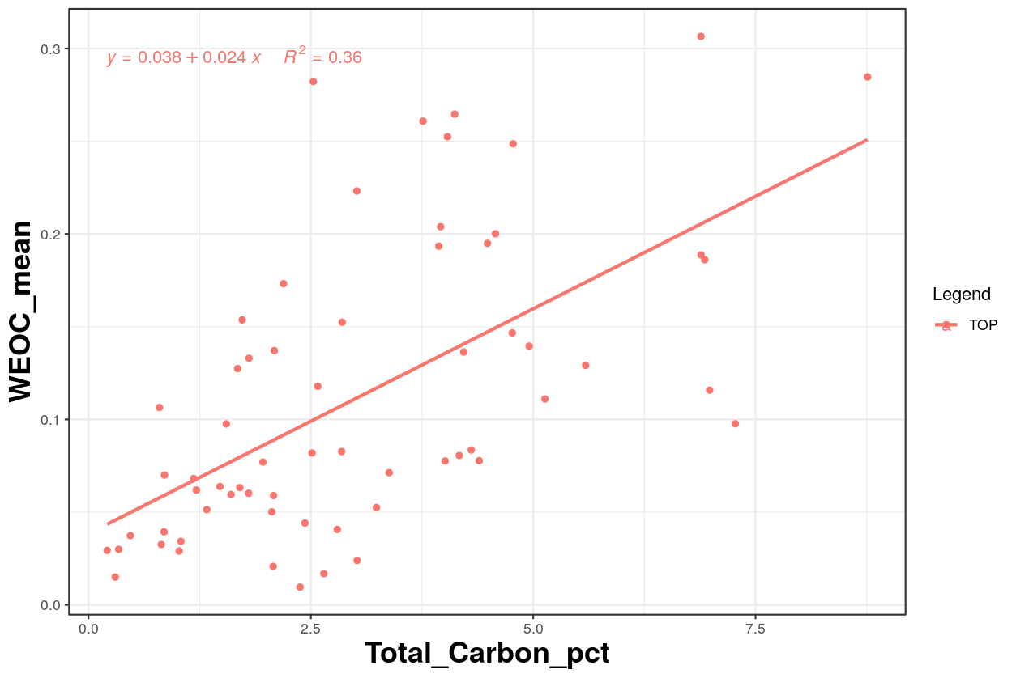
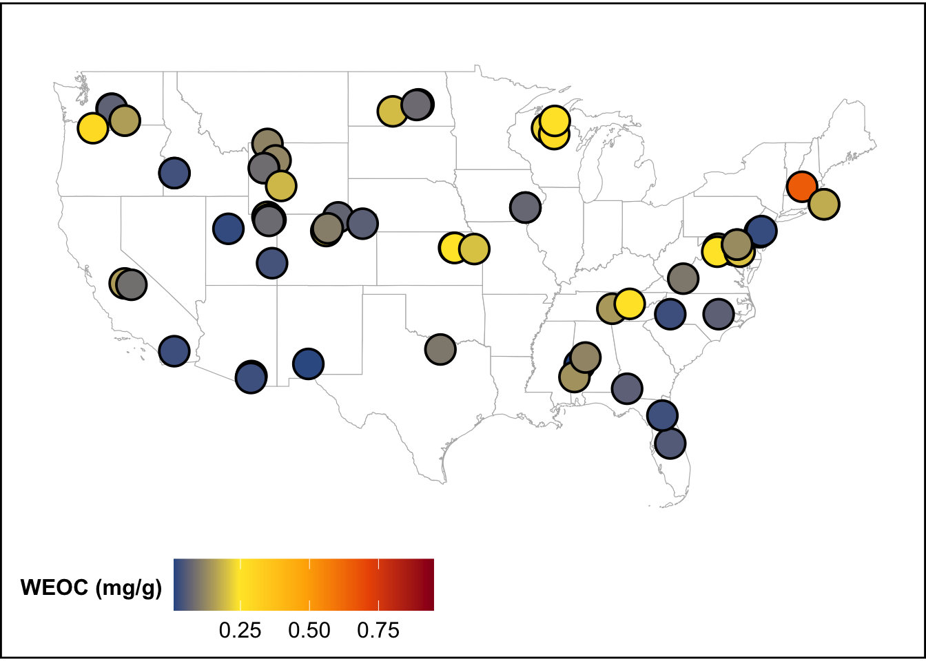
TC vs. WEOC

Slide 31








Cation Exchange Capacity (CEC)
Measure of soil to retain readily exchangeable cations that neutralize the negative charge of soils
Saturate the exchange sites with ammonium
Flush ammonium, replace with H⁺
Notes:
Ammonium replacement method:
Saturate the exchange sites with ammonium
Remove the ammonium and replace with HCl
Measure of soil to retain readily exchangeable cations that neutralize the negative charge of soils.

Slide 32
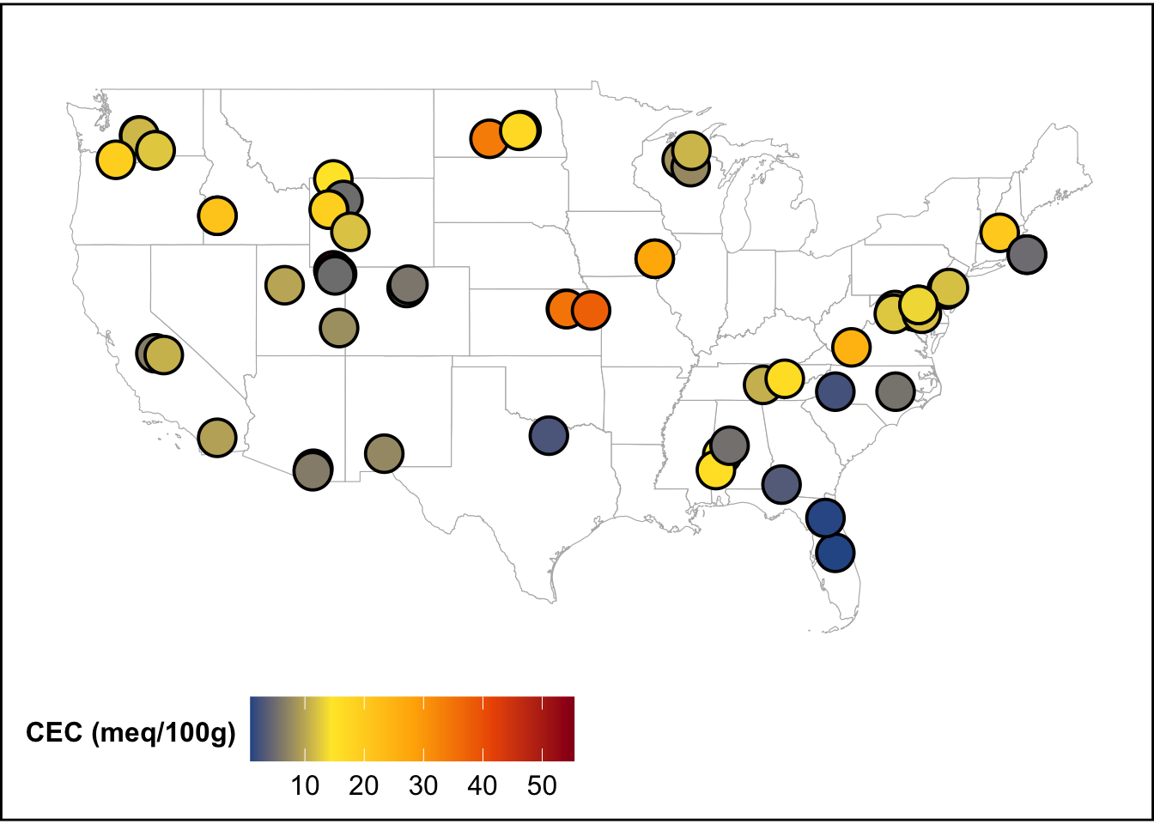
Cation Exchange Capacity (CEC)
Notes:
Ammonium replacement method:
Saturate the exchange sites with ammonium
Remove the ammonium and replace with HCl
Measure of soil to retain readily exchangeable cations that neutralize the negative charge of soils.

Slide 33
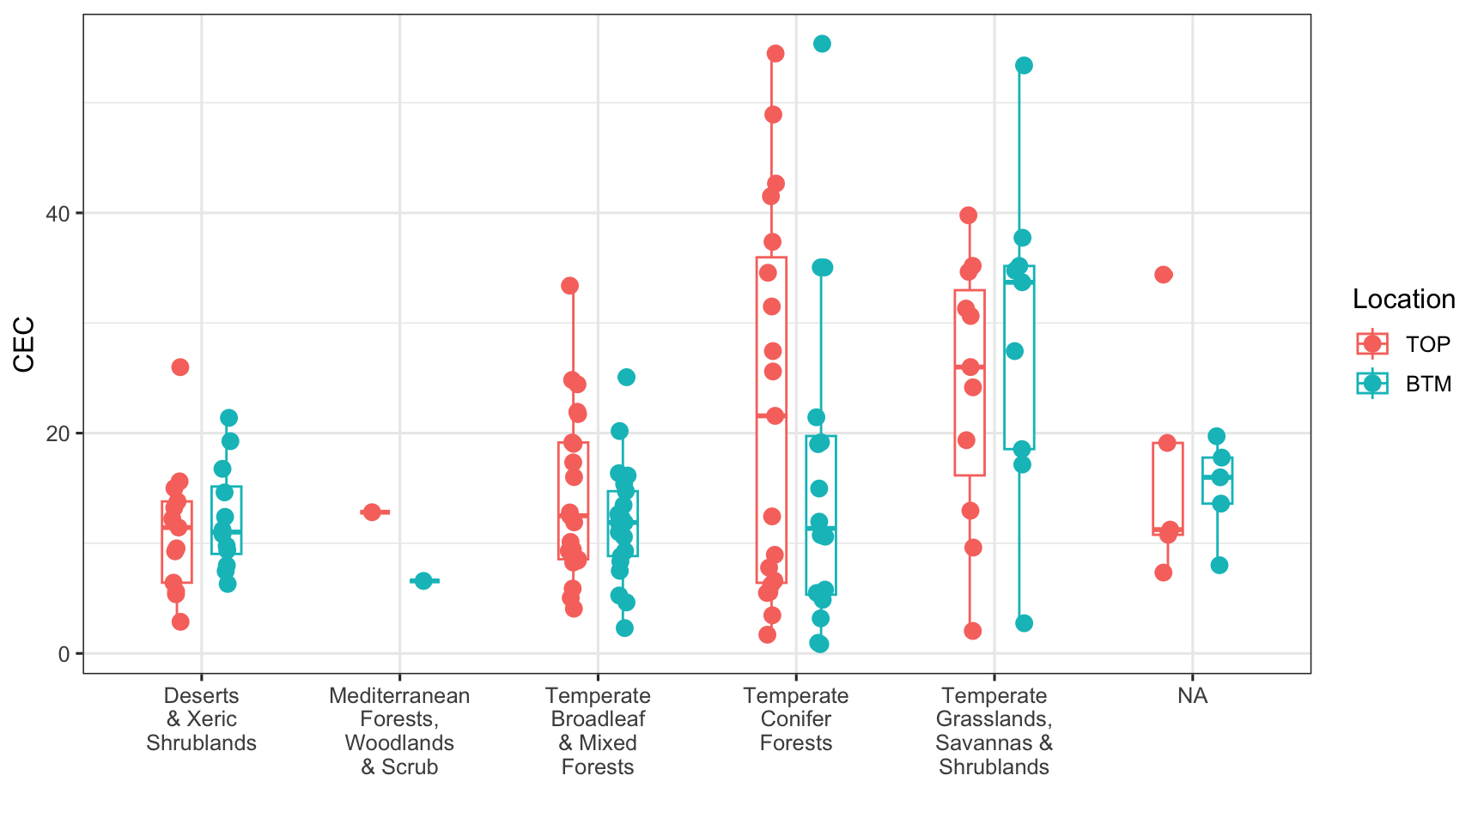
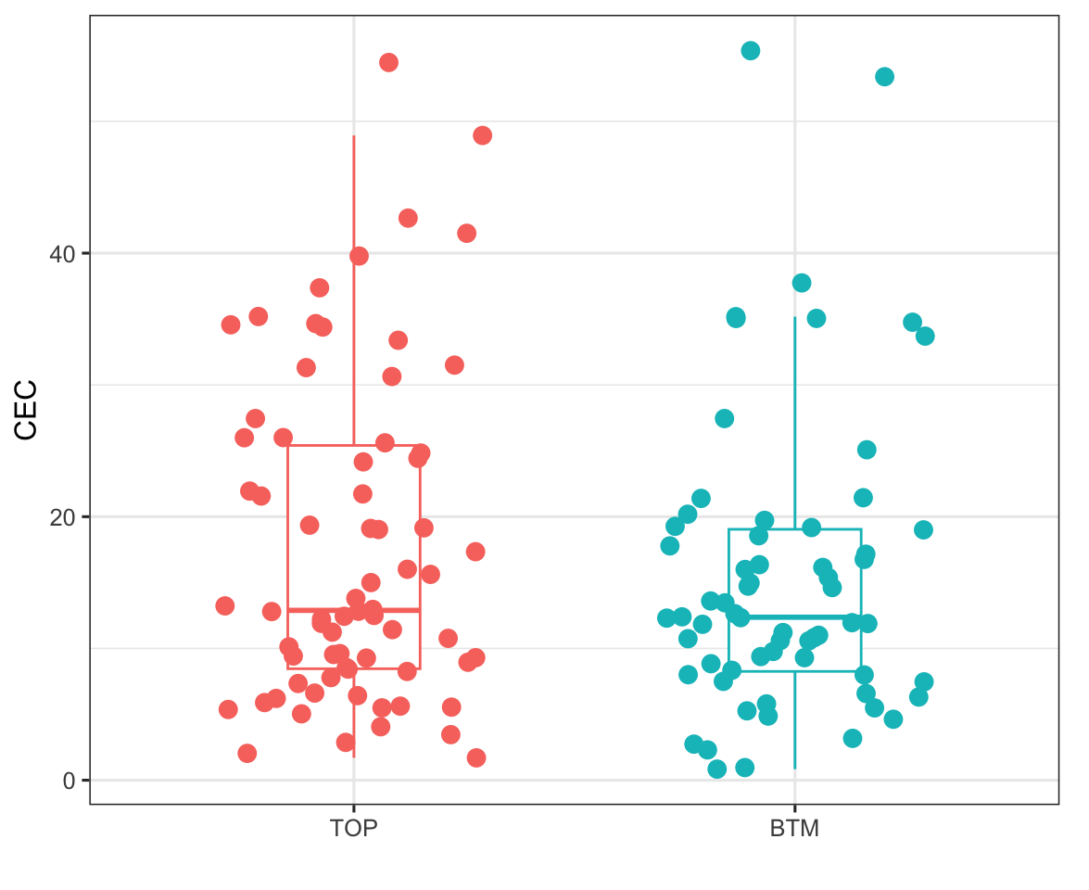
Cation Exchange Capacity (CEC)
CEC significantly influenced by biome

Slide 34
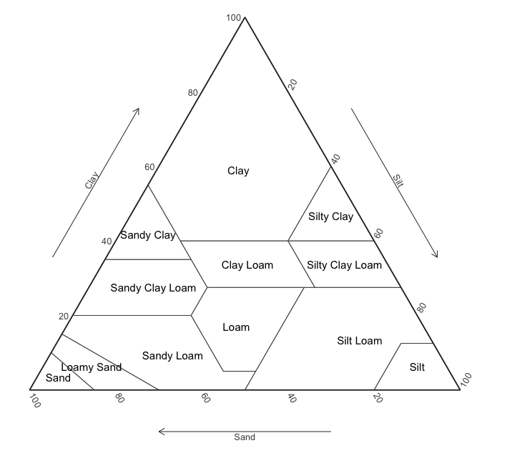

Texture
Hydrometer method

Slide 35
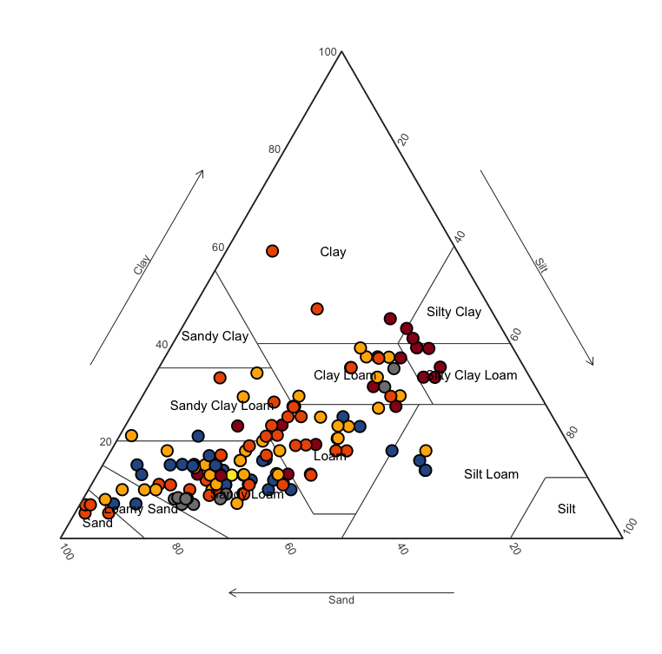
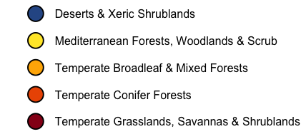
Texture

Slide 36
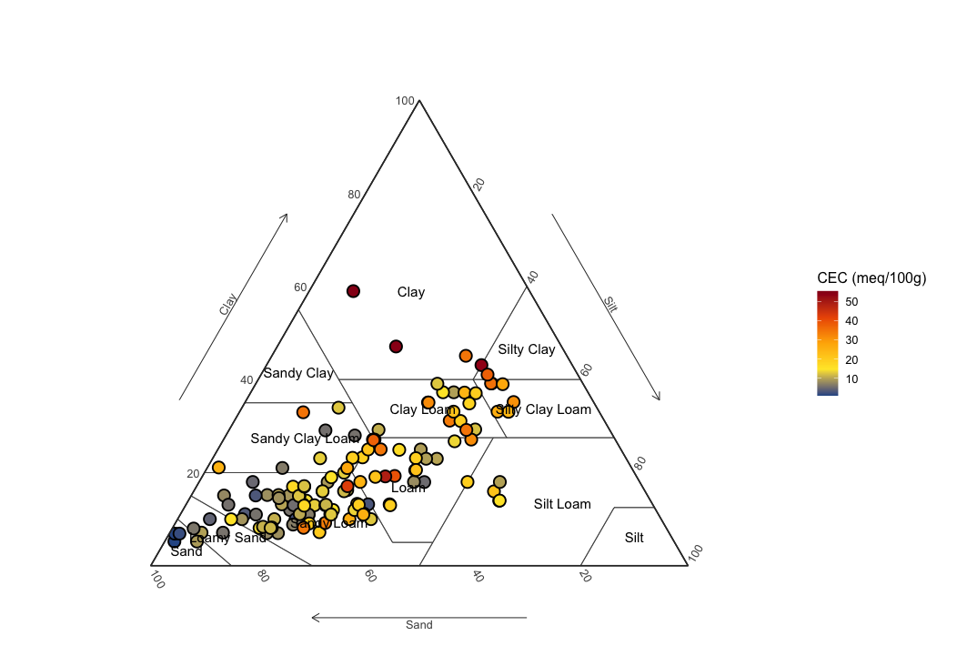
Texture
Texture drives Cation Exchange Capacity

Slide 37

TOMORROW (Session 4)
Hands on learning session
Pre-requisites:
MS Excel
R and RStudio
Before the session:
Download the tutorials from our GitHub repository

